Slide 1
CEIS 114 Final Project Deliverables PowerPoint
Name: Joseph Lane
Professor: Dr. Bola Tilghman
Session: May 2025
Date: Due – 6/28/2025

Slide 2

Project Motivation and End Goal
Gain experience using the ESP32 microcontroller
Learn how to utilize the website WOKWI for further study and design
Expand IoT knowledge by designing and building a functioning virtual two-way traffic light controller. Requirements include pedestrian crossing, emergency signal, LCD integration.
The purpose of the project is to build an intelligent IoT solution to promote efficient congestion control, increase the safety of the populous and reduce environmental impacts.
Develop practical skills in the areas of microcontroller programming, IoT functionality, traffic engineering and principles of electronics.

Slide 3
Module 2 – 1st week of project development highlights
Create a WOKWI account and familiarize myself with the platform
Begin exploratory work on the ESP32 microcontroller
Wire the microcontroller for power on our project board
Test the microcontroller with a WIFI scan.
WIFI scan code is available in the GitHub repository called wifi_scan.cpp
* Libraries are not set up in the code, they have a special tab in the WOKWI UI. See the file libraries.txt in GitHub

Slide 4
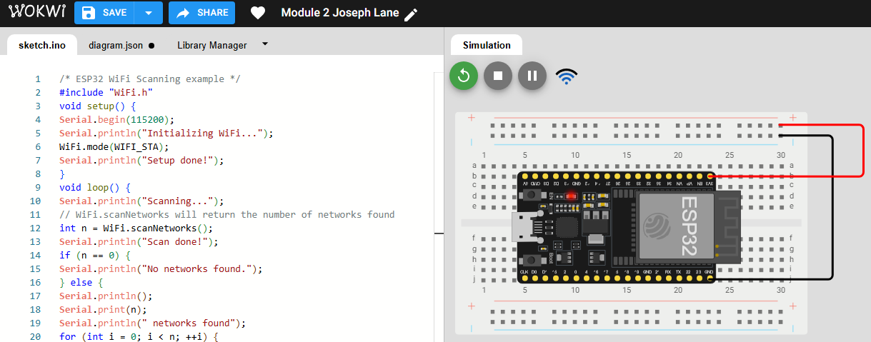
Screenshot of ESP32 Microcontroller wired for power and UI setup
Microcontroller mounted and powered ON

Slide 5
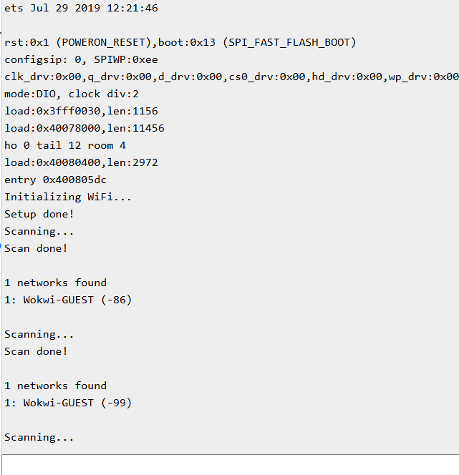
ESP32 WiFi Scan
Screenshot of Serial Monitor showing the available networks

Slide 6
Module 3 – 2nd week of project development highlights
Continue building on the previous weeks progress
Large focus on the electronics piece of the project. Introduction of Ohm’s law: V=IR or Voltage = Current* Resistance
Wire the first virtual traffic light with LEDs
Assign each positive wire to a microcontroller port and identify how to use that in our code.
LED control code is available in the GitHub repository called one_traffic_light.cpp
* Libraries are not set up in the code, they have a special tab in the WOKWI UI. See the file libraries.txt in GitHub

Slide 7
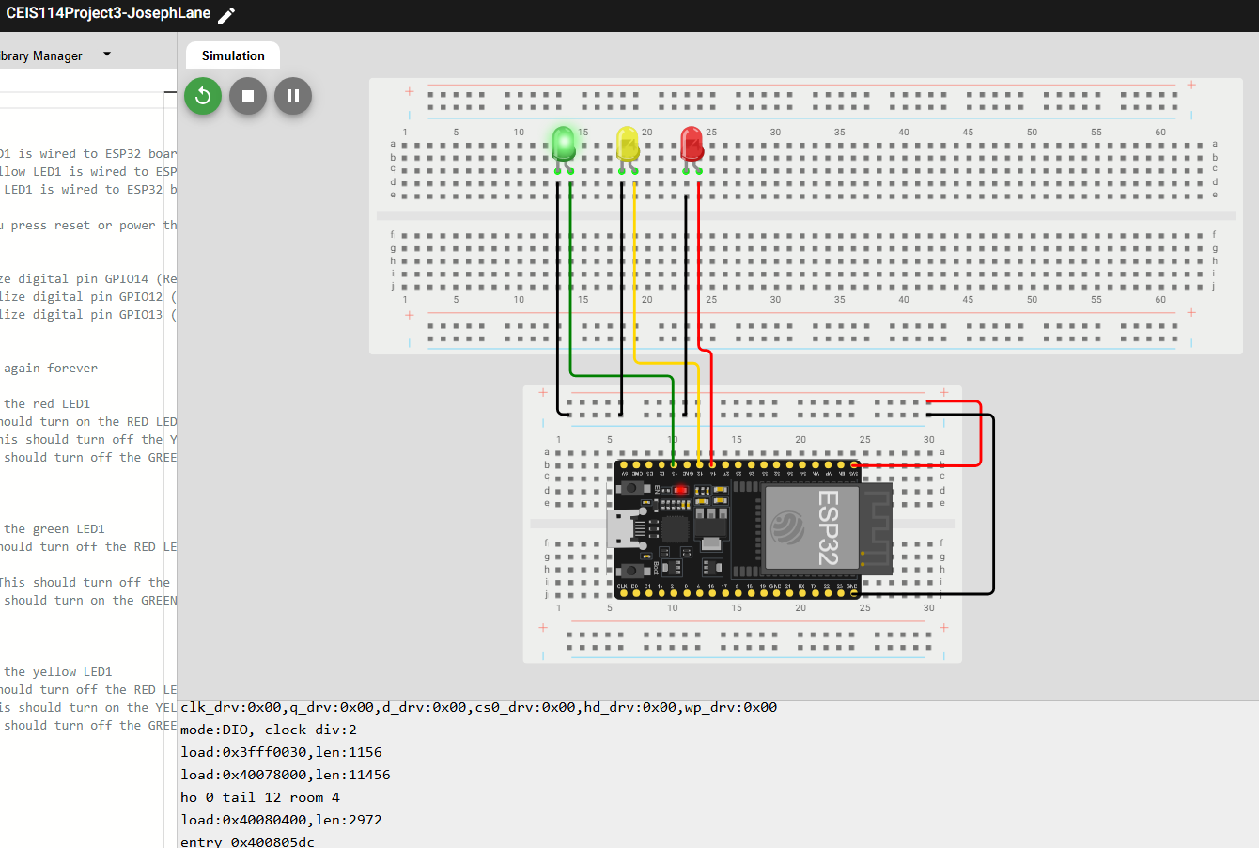
Picture of circuit with working LEDs
Includes:
ESP 32 Board
Colored LEDs: Red, Yellow and Green Wires
Breadboard

Slide 8
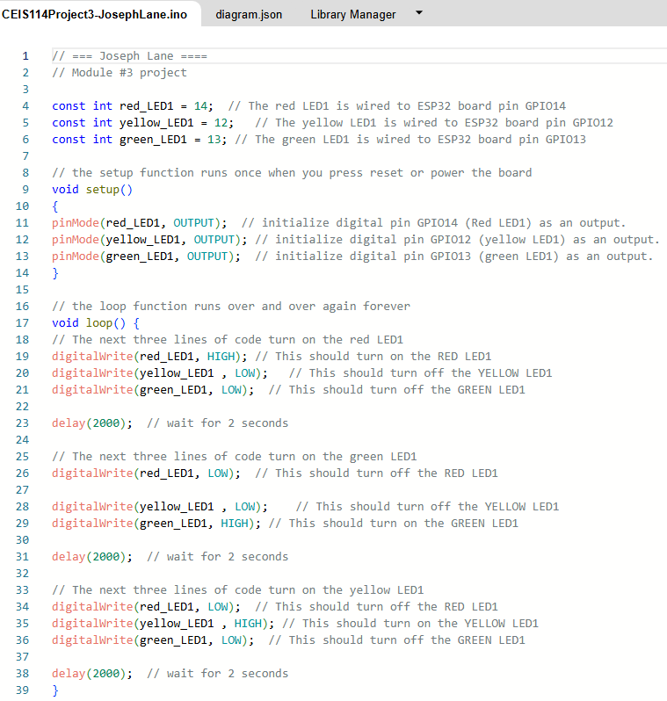
ESP32 LED Use
Screenshot of code in the Code Editor showing LED on/off functionality

Slide 9
Module 4 – 3rd week of project development highlights
Continue building on the previous weeks progress - again
Conversion to a multiple traffic light controller
Wire in additional LEDs for 2nd set of lights
Adapt code to work with alternating 2nd set of lights, creating a rudimentary traffic control system
Adapted code is available in the GitHub repository called two_traffic_lights.cpp
* Libraries are not set up in the code, they have a special tab in the WOKWI UI. See the file libraries.txt in GitHub

Slide 10
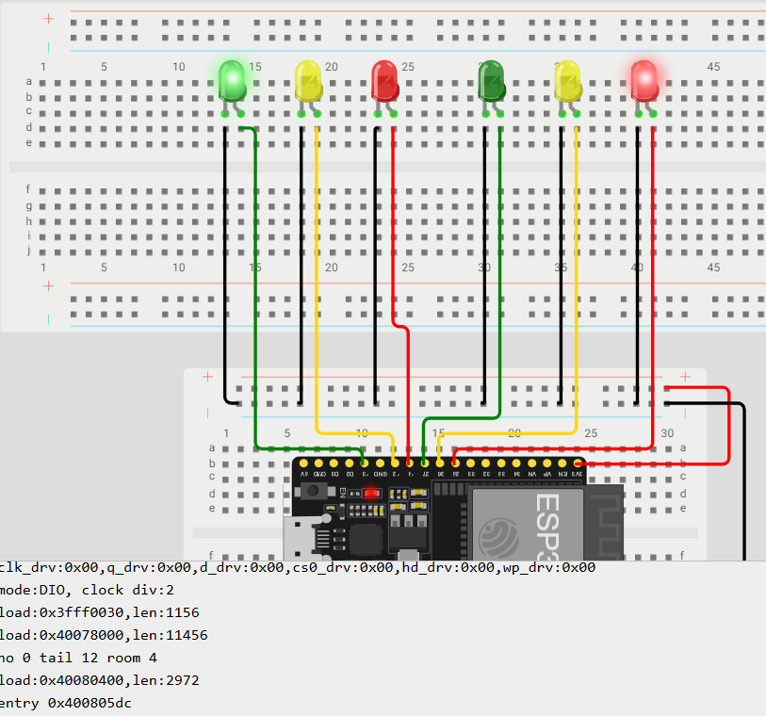
Picture of circuit with working LEDs
Includes:
ESP 32 Board
Colored LEDs: Red, Yellow and Green (two sets of wires)
Breadboard

Slide 11
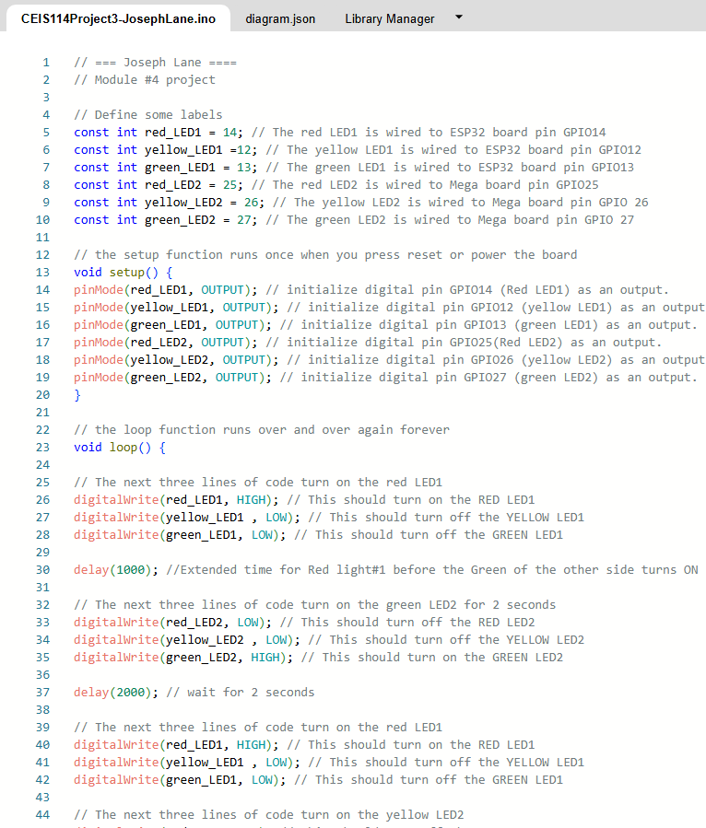
ESP32 Alternating Lights
Screenshot of code in the Code Editor showing LED on/off functionality with two alternating light patterns

Slide 12
Module 5 – 4th week of project development highlights
Continue building on the previous weeks progress - again
Introduction of a safety feature – the crosswalk
Wire in a button to trigger event
Adapt code to utilize button feedback and enable the routine for the crosswalk
Adapted code is available in the GitHub repository called crosswalk.cpp
* Libraries are not set up in the code, they have a special tab in the WOKWI UI. See the file libraries.txt in GitHub

Slide 13
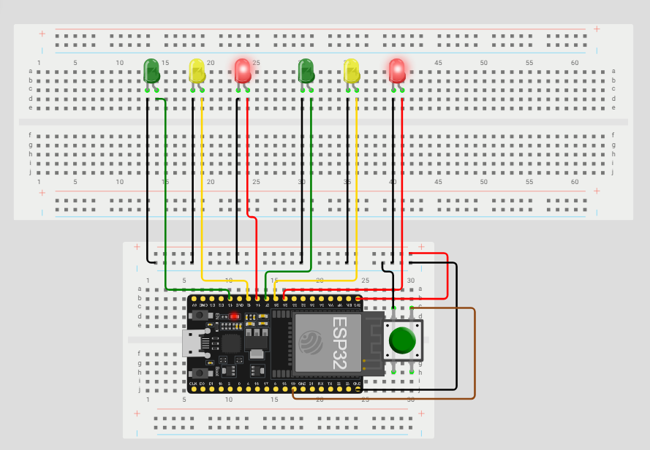
Picture of circuit with working LEDs
Includes:
ESP 32 Board
Colored LEDs: Red, Yellow and Green (two sets of wires)
220 Ohm Resistors (optional)
Push Button
Breadboard

Slide 14
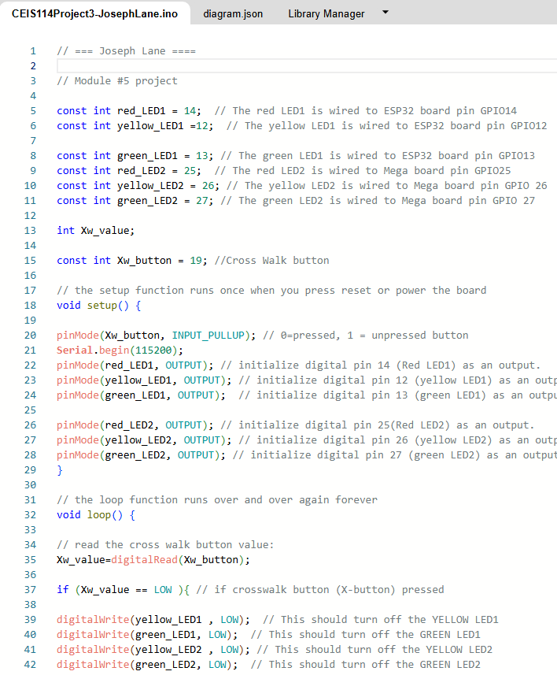
ESP32 Crosswalk Implementation
Screenshot of code in the Code Editor showing activity upon firm button press

Slide 15
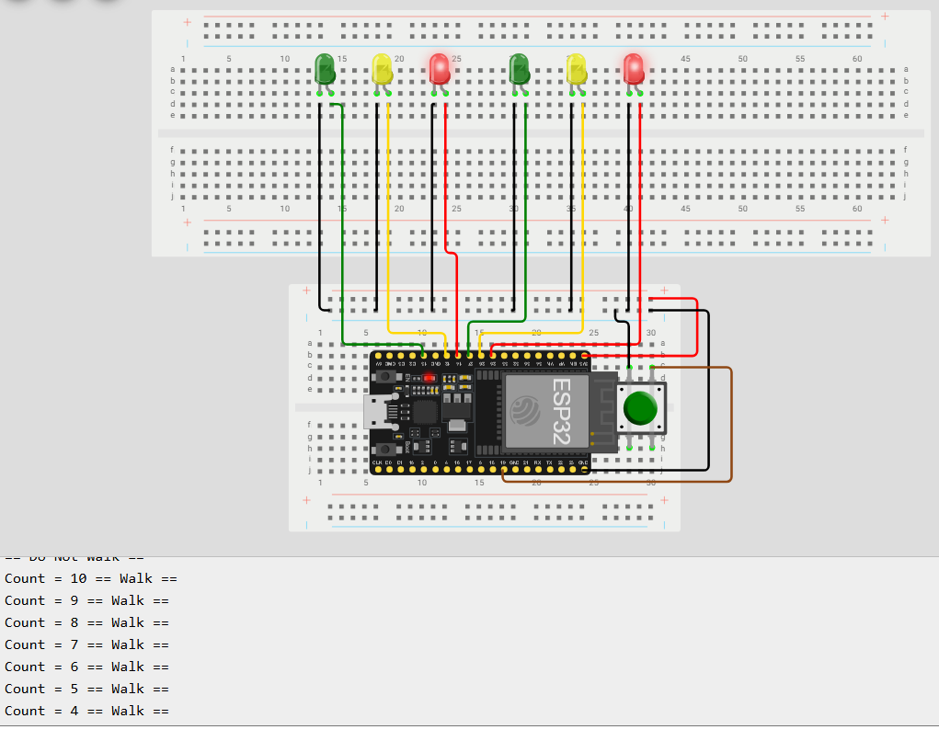
Screenshot of the code change effects on current wiring
Also shows output in Serial Monitor of walk countdown

Slide 16
Module 6 – 5th week of project development highlights
Continue building on the previous weeks progress - again
Creating a Multiple Traffic Light Controller with a Cross Walk and an Emergency Buzzer
Emergency Buzzer is a further safety implementation. All lights and crosswalk stop.
Adapt code to utilize buzzer and implement an LCD display showing light status.
Adapted code is available in the GitHub repository called emergency_inclusion.cpp
* Libraries are not set up in the code, they have a special tab in the WOKWI UI. See the file libraries.txt in GitHub

Slide 17
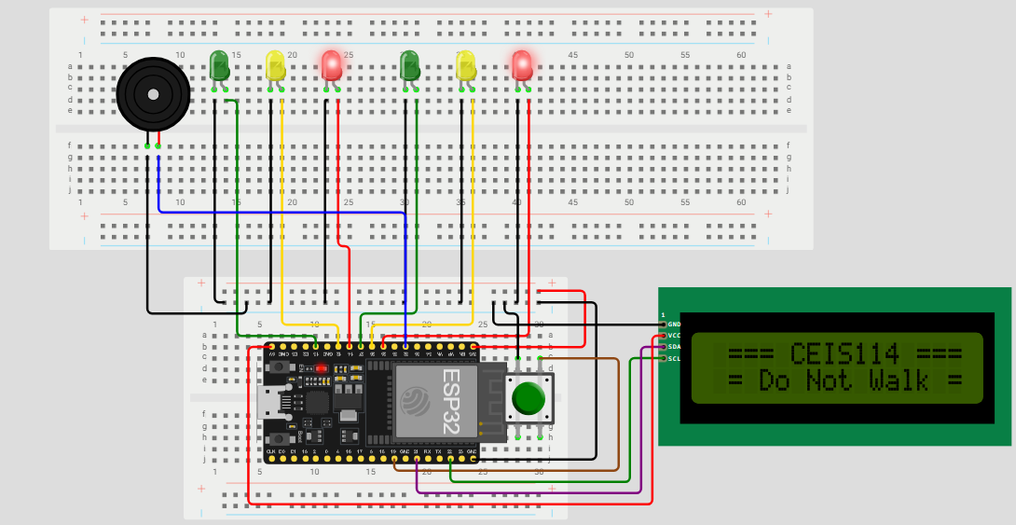
Picture of circuit with working LEDs and LCD display
Includes:
ESP 32 Board
Colored LEDs: Red, Yellow and Green (two sets of wires)
220 Ohm Resistors (optional)
Push Button
LCD Unit with Message Display
Additional wiring
Breadboard
Emergency buzzer

Slide 18
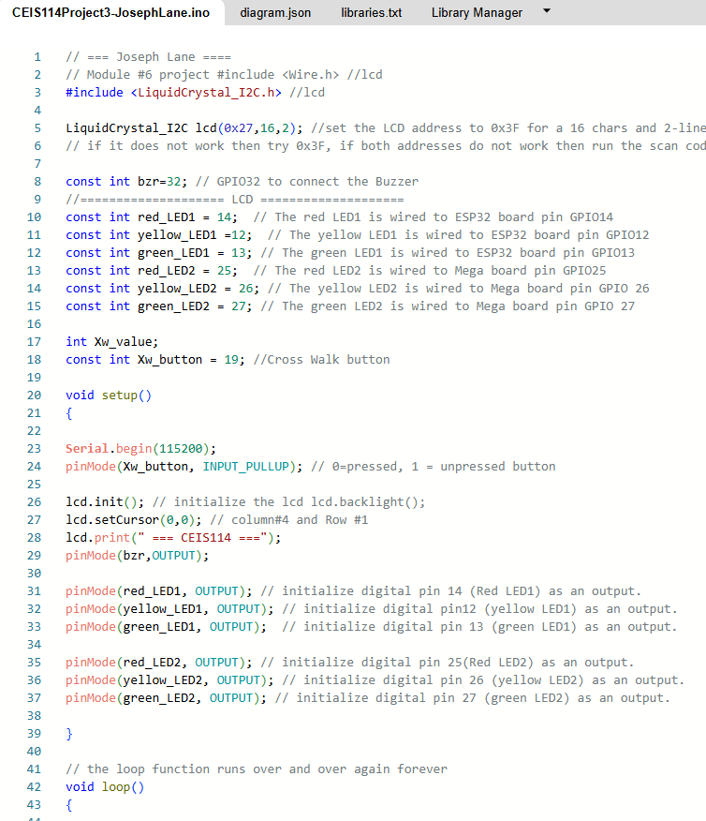
ESP32 LCD and Emergency buzzer
Screenshot of code in the Code Editor showing activity feedback on LCD screen and Emergency code implementation

Slide 19
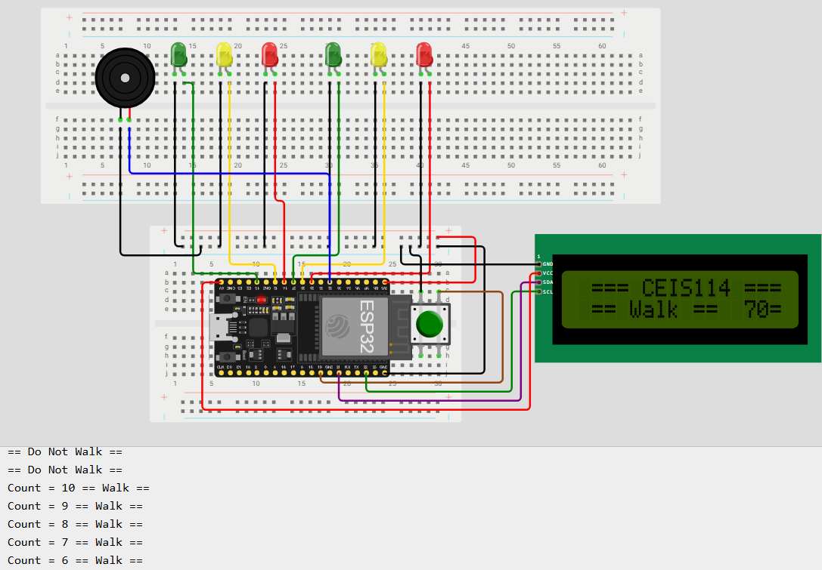
Picture of circuit with working LEDs and LCD display
Screenshot of output in Serial Monitor showing the Do Not Walk and Crosswalk functionality

Slide 20
Module 7 – 6th and final week of project development highlights
Continue building on the previous weeks progress - again
Creating a Multiple Traffic Light Controller with a Cross Walk and an Emergency Buzzer with secured IoT Control via Web
Final code implementation with inclusion of Android application which works with the lights remotely to trigger emergencies
Adapted code is available in the GitHub repository called final_IoT_access.cpp
* Libraries are not set up in the code, they have a special tab in the WOKWI UI. See the file libraries.txt in GitHub

Slide 21
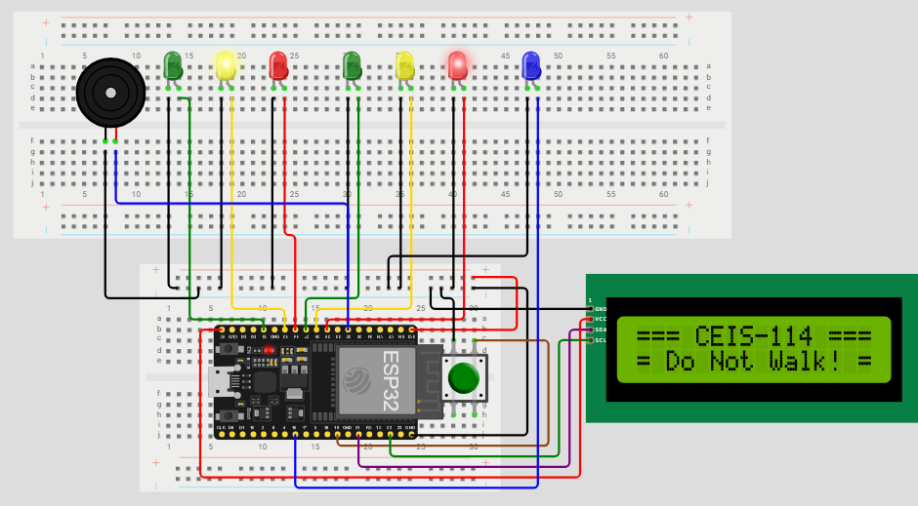
Picture of final circuit with working LEDs and LCD display
Includes:
ESP 32 Board
Colored LEDs: Red, Yellow and Green (two sets of wires)
One Blue LED – Emergency Light
Push Button
LCD Unit
Buzzer
Additional Wiring
Breadboard

Slide 22
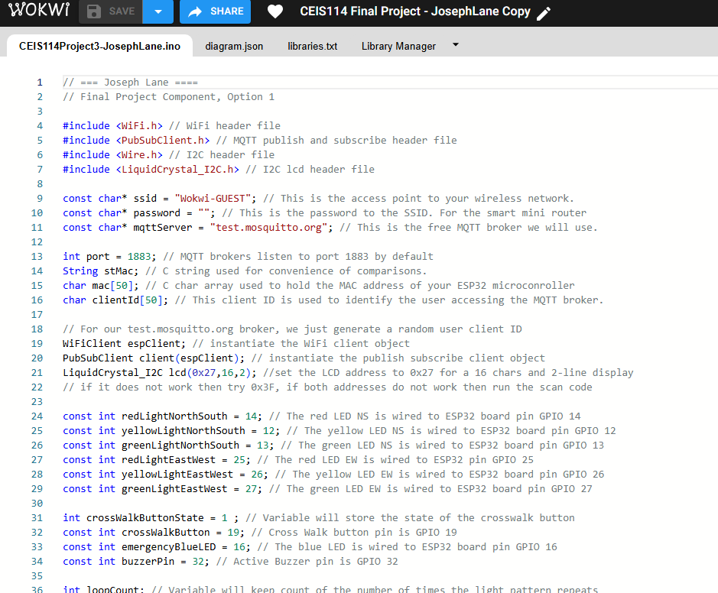
ESP32 Final and complete implementation
Screenshot of code in the Code Editor showing additional code to complete out the project and include remote application for IoT interactivity

Slide 23
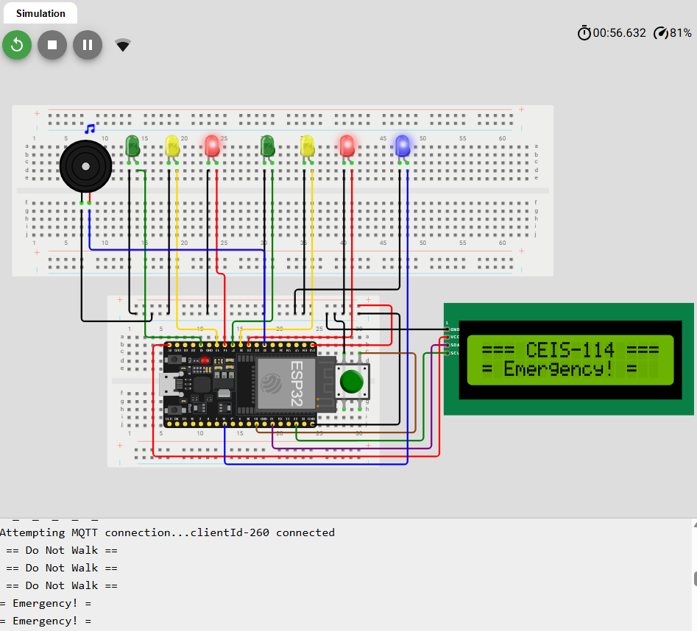
Screenshot of Serial Monitor (Testing)
Screenshot of output in Serial Monitor showing the implemented Emergency functionality via remote application

Slide 24
Challenges
My background in electronics is not very robust. I’ve learned enough to get an A+ certification and work on computers over the years, but I’ve never really understood exactly how power works on a closed circuit. This took me quite a bit of time to study as I kept leaping from electronics subject to electronics subject as I became more interested along the way.
Learning to use the website WOKWI was a learning curve. It seems they’ve added some pay gaps in since prior instructional videos were produced. After getting familiar with the platform, it ended up becoming much easier.
My primary OS at home is Linux, there are some compatibility issues around using Linux and all the course tools. Especially around uploading deliverables. I ended up installing Oracle VirtualBox with a copy of Windows 11 Home that came with the laptop specifically to work with PowerPoint files and submit assignments.
For this assignment, WiX is a very difficult platform to get things exactly the way you want. I learned that in a previous course. This time I opted to use my existing GitHub profile with custom domain name.

Slide 25
Career Skills
This project reinforced the need to break down projects into approachable chunks of deliverables. While not the Agile method, this is a very important skill to have and work towards mastering no matter what field you work in
I’m lucky enough to have had a very long career in Business Intelligence, Management Analytics, and have seen the many changes in data platforms and warehousing philosophies over the years. This course was eye-opening on how much IoT is changing the way businesses get data and the importance of being able to make decisions on data that is constantly changing. This is a very large part of what I manage in my career. We are so often creating data-marts and aggregated datasets in the cloud that we lose sight of the data sources that constantly supply live data for consumption. We need to do a better job adapting to these changes to stay relevant with the changes that IoT is bringing.
Presentation building is ALWAYS a good skill to hone. As my career advanced, I found myself moving into more of a role as a teacher/mentor and consistently pitching ideas or recommendations to senior leadership.
After over 25 years working with data analytics, warehousing, and management I find myself becoming much more interested in IoT. The various topics that we covered were a great follow-up to my previous IoT coursework and I may just be looking to change career direction soon.

Slide 26
Conclusion
In closing, I’m very appreciate of Dr. Tilghman and the way she has structured this coursework as well as the feedback she provided along the way. I am excited to continue learning about IoT, the cloud, and whatever else my courses throw at me.
This course included a melting-pot of topics including multiple areas of electronics, virtual project tools, Arduino C++, IoT fundamentals, project design/implementation, team learning, and many best practices along the way. I’m looking forward to some self-study and Arduino project implementations over the summer, there may even be some business ideas floating around as well!
My hope is that anyone who comes across the project really takes the time to look at the materials and think deeply about just what IoT can accomplish for not only self gratification but publish service as well. There is quite the opportunity here to do some significant good for the community. All you need is an open mind, careful consideration, and lots of support and feedback.
Thank you for taking the time to relive this journey with me. Please feel free to reach out to me at joseph.lane@outlook.com with any questions or even just to be a sounding board.
-Joe

Slide 27
Final project’s Wix link (or personal webpage)
I opted to utilize my old GitHub site that I’ve recently been revitalizing as the Project site rather than Wix. Personally, I find Wix to be very restrictive when wanting to customize their portal pages or do something truly unique.
I am still working through setting up the portal landing page and adding projects, but it should still be much better than Wix.
https://www.joseph-lane.com/
This site will eventually be the complete portal for all projects. It is hosted on GitHub.
https://github.com/jlane003/smart_traffic_ceis114
The full project repository for this presentation can be found at this location.

Slide 28
Appendix

Slide 29
EIS.CEIS114.W8COURSE_PROJECT.MAR24
Total Points: 85
Criteria | Ratings | Pts
Apply basic programming to support IoT device (Smart Traffic Light Controller) threshold: 15.0 pts | 20 ptsThe project has no programming concepts errors. 15 ptsThe project has 1 or more programming concepts errors. 10 ptsThe project has 2 or more programming concepts errors. 5 ptsThe project has 3 or more programming concepts errors. 0 ptsNo Programming Completed | 20 pts
Classify the things or devices that make up the IoT (Smart Traffic Light Controller) threshold: 24.0 pts | 30 ptsThe project was built using relevant technologies and IoT principles effectively and appropriately with no errors. All five circuit setup pictures were included: 1. Two sets of Traffic Lights 2. Push Button 3. LCD Panel 4. Buzzer 5. IOT Button or Motion Detector. 24 ptsThe project was built using relevant technologies and IoT principles effectively and appropriately with one of the following missing1. Two sets of Traffic Lights 2. Push Button 3. LCD Panel 4. Buzzer 5. IOT Button or Motion Detector. 15 ptsThe project was built using relevant technologies and IoT principles effectively and appropriately with two of the following missing1. Two sets of Traffic Lights 2. Push Button 3. LCD Panel 4. Buzzer 5. IOT Button or Motion Detector. 7 ptsThe project was built using relevant technologies and IoT principles effectively and appropriately with three of the following missing: 1. Two sets of Traffic Lights 2. Push Button 3. LCD Panel 4. Buzzer 5. IOT Button or Motion Detector. 0 ptsNo project was built. | 30 pts
Design and produce an IoT system (Smart Traffic Light Controller) threshold: 15.0 pts | 20 ptsSystem was built, coded, and tested in a Virtual environment and/or IoT Kit with no errors. 15 ptsSystem was built, coded, and tested in Virtual Environment and/or IoT Kit with one or more errors. 10 ptsSystem was built, coded, and tested in Virtual Environment and/or IoT Kit with two or more errors. 5 ptsSystem was built, coded, and tested in Virtual Environment and/or IoT Kit with three or more errors. 0 ptsNo Project was built. | 20 pts
Explain the interconnectivity of devices in the IoT (Smart Traffic Light Controller) threshold: 10.0 pts | 15 ptsFinal project submitted in the form of a professional presentation including transitions between modules projects. Other slides include title slide, introduction slide, challenges in the project slide, career skills slide, slides describing each module, and conclusion slide. 10 ptsFinal project submitted in the form of a professional presentation including transitions between modules. Missing one or two of the following: title slide, introduction slide, challenges in the project slide, career skills slide, slides describing each module, and conclusion slide. 5 ptsFinal project submitted in the form of a professional presentation including transitions between modules. Missing three to four of the following: title slide, introduction slide, challenges in the project slide, career skills slide, slides describing each module, and conclusion slide. 3 ptsFinal project submitted in the form of a professional presentation including transitions between modules. Missing all additional slides. 0 ptsFinal project presentation was not completed. | 15 pts

